Slide 1

BANK MANAGEMENT system
Presented By:
BHAVANA S (51914422)
CHANRA LEKHA Y (51913892)
NITESH PANDEY (51913995)
RAM ASHIS MAURYA (51913996)
S. D. MOHANMURALI (51916594)
SHAIK KALESHA MASTAN VALI (51914073)

Slide 2
CONTENTS
Company Overview
Overview of project
Project Description
Scope and Non-Scope
Technical Requirements
Use case Requirements
Output
Automation Testing

Slide 3
Company Overview
Started in the year 1976 at Noida, Uttar Pradesh in India
Founder: Shiv Nadar
First Indian IT services (hardware company)
Before the HCL technologies India had only 250 computers
In 1978, HCL developed the first indigenous micro-computer at the same time as apple
The first RDBMS in 1983, client-server architecture in 1984, and fine-grained multiprocessor UNIX installation in 1989
R&D division was spun off as HCL Technologies in 1991 to enter the software services arena
Presence in 35 countries
Shiva Nadar initially invested 20 lacks for starting HINDUSTAN COMPUTER LIMITED

Slide 4
OVERVIEW OF PROJECT
The Bank Management system is deployed using the following SDLC model.
SDLC - Agile method :
Agile method has become a critical part of application lifecycles and has had a significant impact on software development, testing and quality assurance.
Agile maximizes value throughout the development process and significantly reduces the overall risk of any given project.

Slide 5
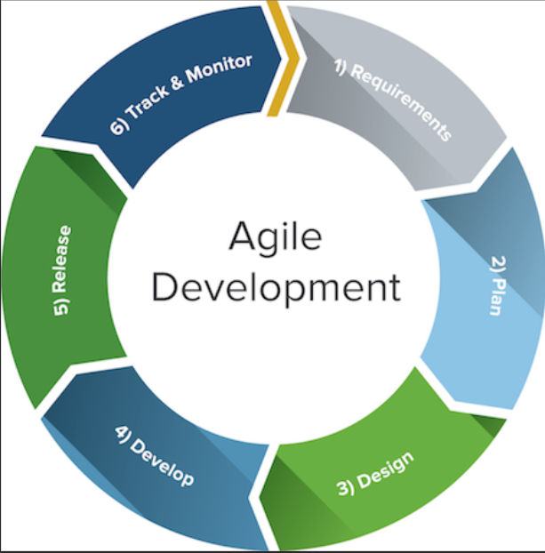
Tasks are divided into modules(deposit, transfer, withdraw, check balance), and each module is assigned to a team to perform.
The modules are integrated at the end to obtained task/project.
Defect detection is easier to find and resolve.

Slide 6
PROJECT DESCRIPTION
It is an application for maintaining a person's account in a bank.
Banking interface is primarily designed for balance inquiry, transfer of funds to another account in the same bank, along with deposit and withdrawal.
It enables customers of a bank or other financial institution to conduct a range of financial transactions.

Slide 7
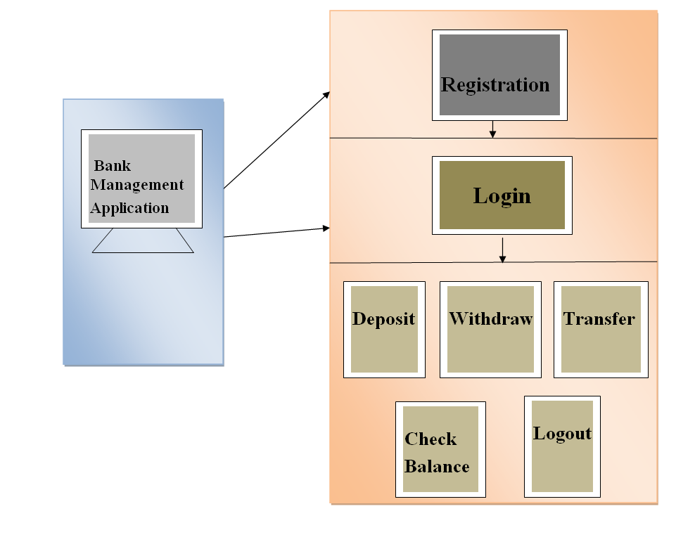
ARCHITECTURE
The project contains the following modules:
Registration
Login
Deposit
Withdrawal
Transfer
Check Balance
Logout

Slide 8
SCOPE AND NON-SCOPE
SCOPE
Banking Management System is the provision of providing financial services using electronic communication and computation.
It provides many benefits to bank consumers in terms of easy, fast and secure transactions.
All transactions are stored in database.
NON-SCOPE
OTP system can be added for authentication, during withdrawal and transfer.
E-Payment modules can also be added to make it more useful.
It can be made online mode, to make transactions more efficient.

Slide 9

TECHNICAL REQUIREMENTS
ECLIPSE
Eclipse is an integrated development environment used in computer programming. It contains a base workspace and an extensible plug-in system for customizing the environment. Eclipse is written mostly in Java and its primary use is for developing Java applications.

Slide 10

MYSQL
MySQL Enterprise Edition includes the most comprehensive set of advanced features, management tools and technical support to achieve the highest levels of MySQL scalability, security, reliability, and uptime. It reduces the risk, cost, and complexity in developing, deploying, and managing business-critical MySQL applications.
Java Database Connectivity(JDBC)
JDBC stands for Java Database Connectivity, which is a standard Java API for database-independent connectivity between the Java programming language and a wide range of databases.

Slide 11
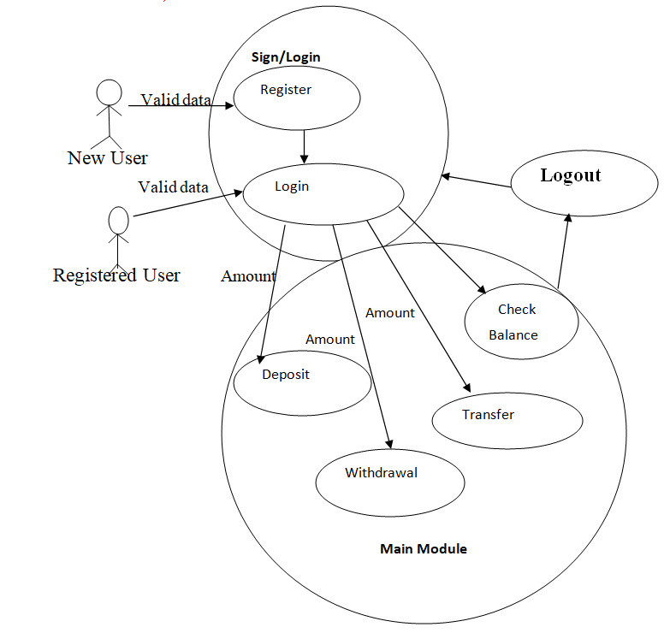
USE CASE REQUIREMENTS
Use case diagrams model the describes functionality of a system using actors and use cases.
Use cases are a set of actions, services, and functions that the system needs to perform.
In Bank management, the new user needs to register, to access the main module functionalities.
The Registered user can login using email and password and can perform Deposit, Withdrawal, Transfer and Check Balance functionalities.

Slide 12
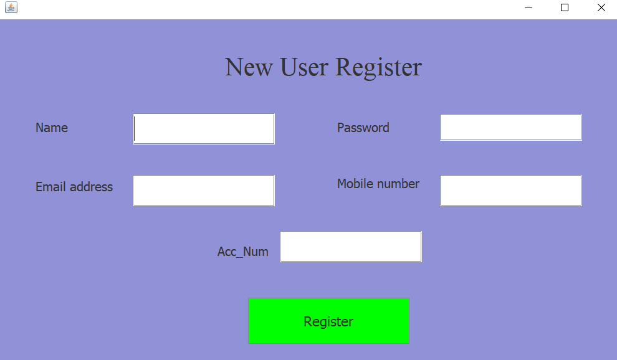
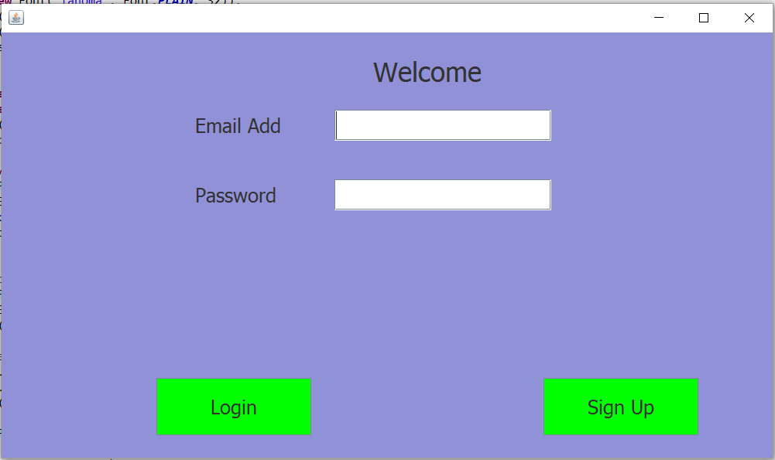
OUTPUT

Slide 13
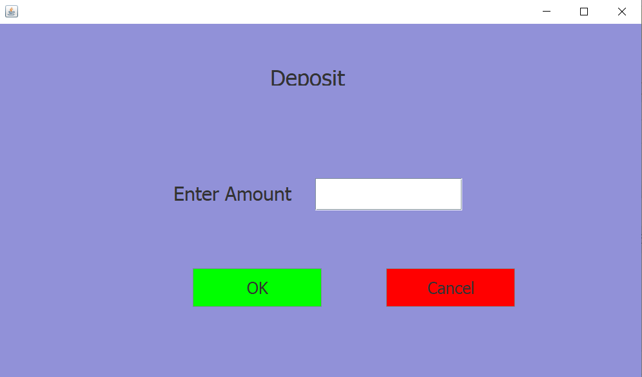

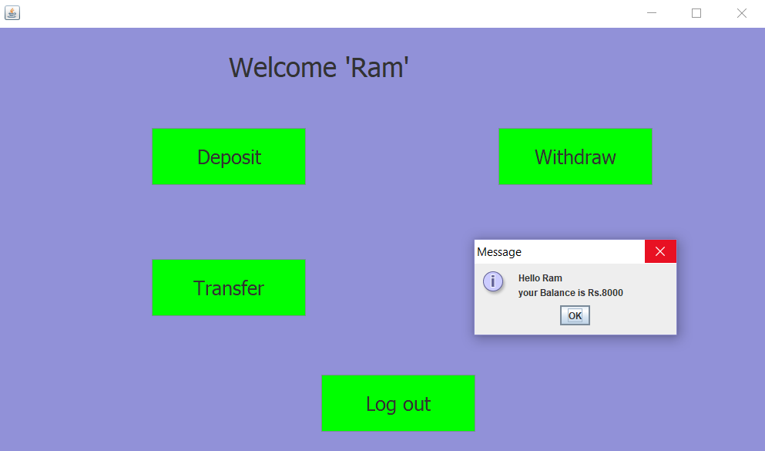
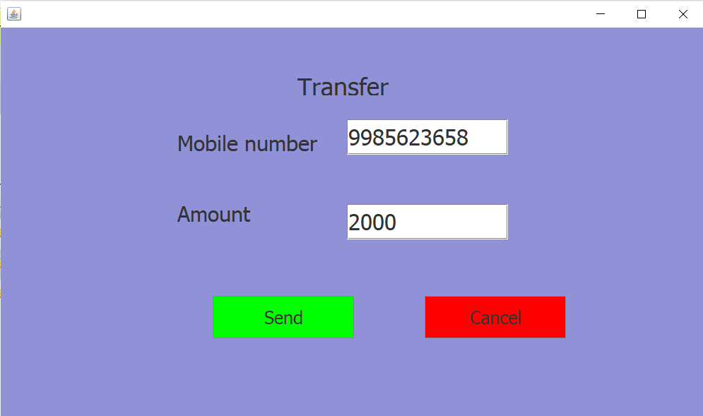

Slide 14
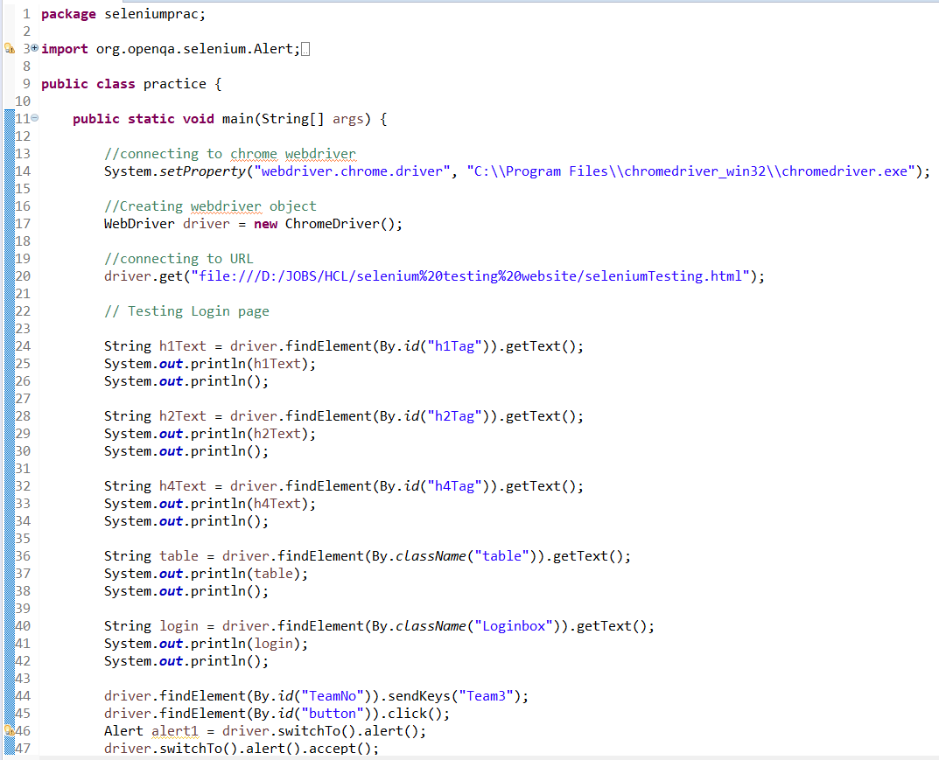
AUTOMATION TESTING
Automation testing is a type of software testing that involves automated test case execution using an automation tool. So, basically it automates the manual testing process.
Selenium testing is done on the created Demo website for the project Bank Management.
The Selenium codes are written in eclipse and executed.

Slide 15
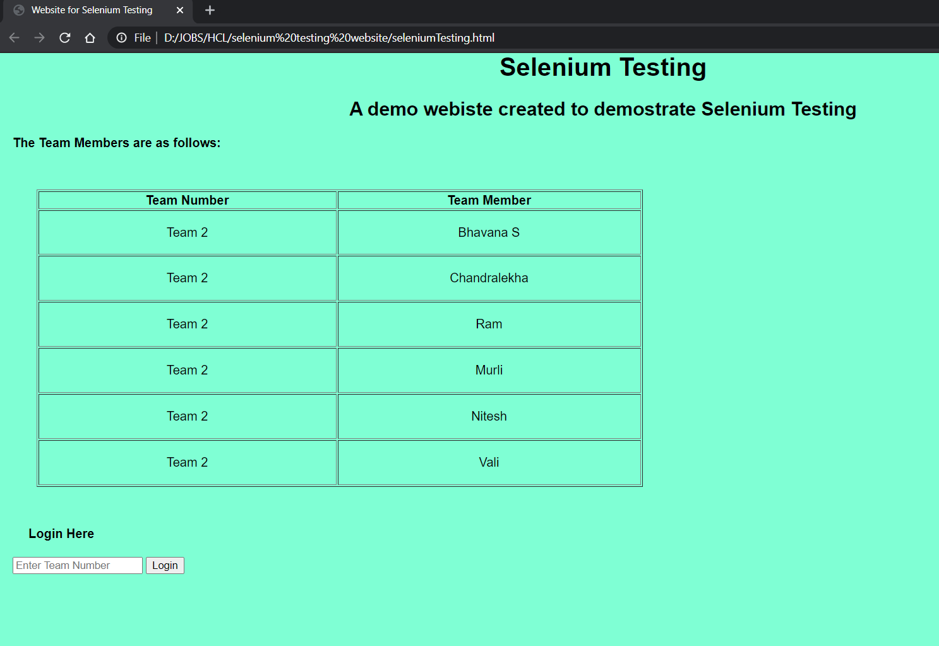
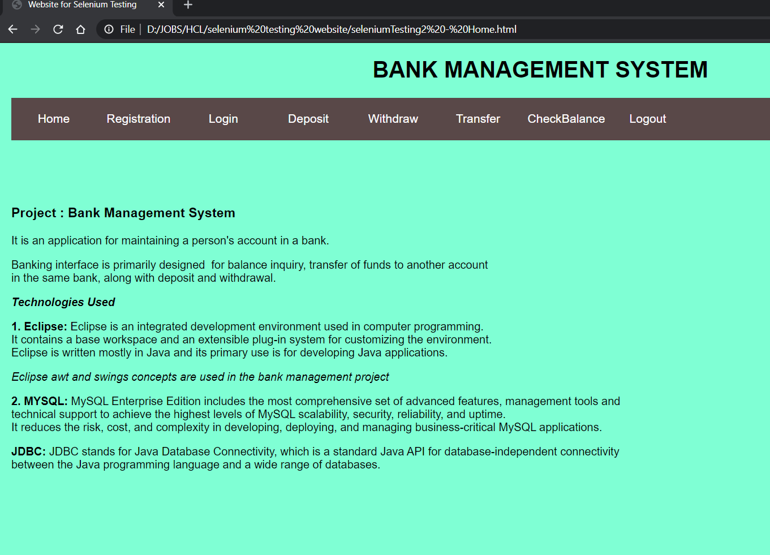
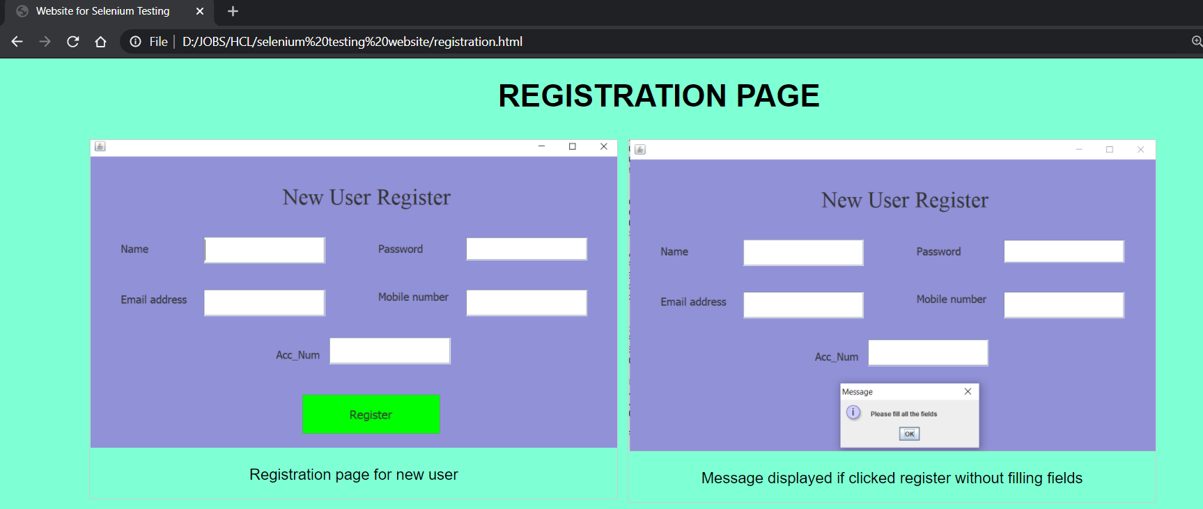
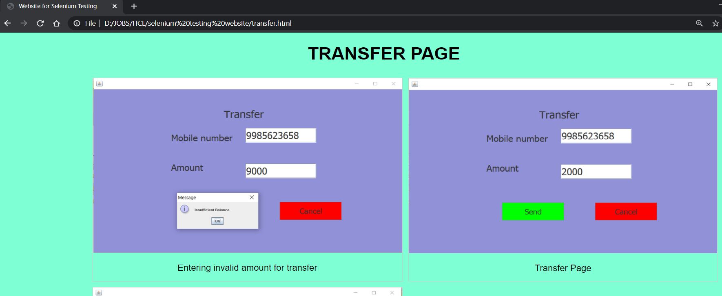

Slide 16
QUESTIONS TIME !!!

